Slide 1
Yelp Dataset – Inverted Index and Clustering on SPARK
Presented by
Vinit D Muchhala
Jatin Navin mistry

Slide 2
Outline
The outline of the project was to build an inverted index using the two different techniques outlined in “Data-Intensive Text Processing with MapReduce”
Clustering on the business dataset to see if some relation exists between the reviews and any one of the business features

Slide 3
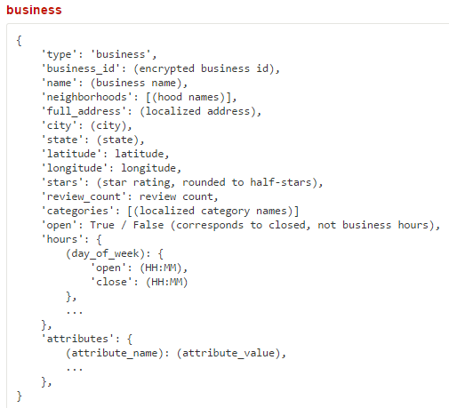
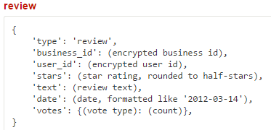
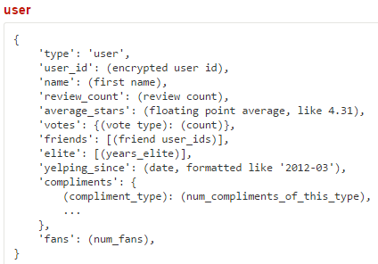
<number>
The Dataset

Slide 4
Inverted Indexing
Retrieval system for normally stored text files getting more difficult due to size of data
Inverted index stores the word as the key and the number of times it appears in a document as the value
This makes it more simple to search and faster

Slide 5
Different techniques of making an Inverted Index
Positional index
Term frequency

Slide 6
Positional Index
In this implementation, we store the index in the below format
(term t:: (document id, position) | (document id, position))
Simplest to make

Slide 7
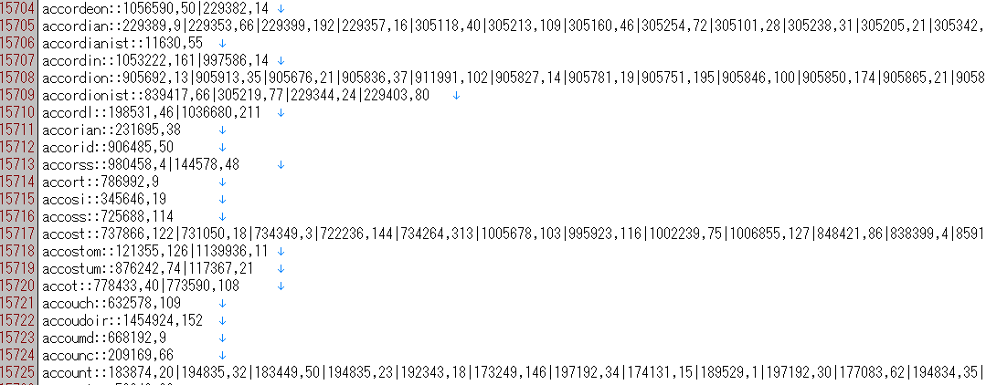
Positional Index

Slide 8
Term frequency
In this implementation, we store the index in the below format
(term t:: (document, term frequency) | (document id, term frequency))
Since we were only interested in retrieving the whole review from the corpus data, just storing the term frequency saved us a lot of space

Slide 9
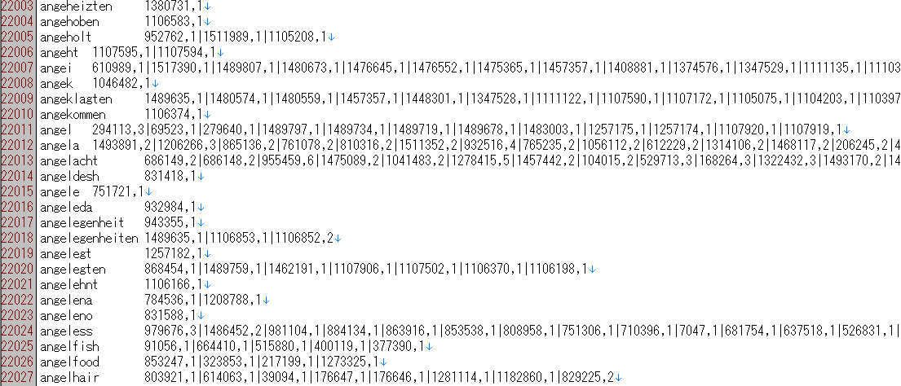
Term Frequency Index

Slide 10
Retrieval
Python script – Load the whole index to memory
Run search on each index
Monitor memory and time usage

Slide 11
Stats
Ran 100 queries (search terms picked at random from corpus data)
On both indices
Search on positional index - 0.19 seconds – on average
Search on term frequency index – 0.09 seconds – on average

Slide 12
Clustering on SPARK
First steps – preprocessing, getting the data into SPARK readable mode
Cluster based on states the business belong to
Determine if the relation between rating and location or any other feature exists prominently

Slide 13
Preprocessing
Python script – to convert json to csv format
Unpack the nested json objects into separate feature space
Ended up with 800+ features

Slide 14
Clustering
Pseudo – code to cluster in MapReduce
Initialize centroids for clusters randomly
Mapper
method map(id, features)
centroids < - read from file
for every centroid do
distance <- features - centroid
emit(nearest centroid, features)

Slide 15
Clustering (contd)
Reducer
method reduce(nearest centroid, features)
for features in nearest centroid:
centroid < - mean(features)
save centroid to file
emit(id, features)

Slide 16
Clustering in SPARK
Initialize K clusters
centers = data.takeSample( false, K, seed)
Assign each data point to closest cluster
closest = data.map(p => (closestPoint(p,centers),p))
Assign each cluster center to be the mean of its cluster’s data points.
pointsGroup = closest.groupByKey()
newCenters =pointsGroup.mapValues(ps => average(ps))

Slide 17
Clustering for Yelp dataset
For our case, clustering was done on per state basis
Clustering algorithm run for every state
Too much data, removes unknown assumptions when clustering to find relation between rating and location or other feature

Slide 18
Plotted the business on maps with ratings
To visually cluster, data plotted on map
Relays location and rating data

Slide 19
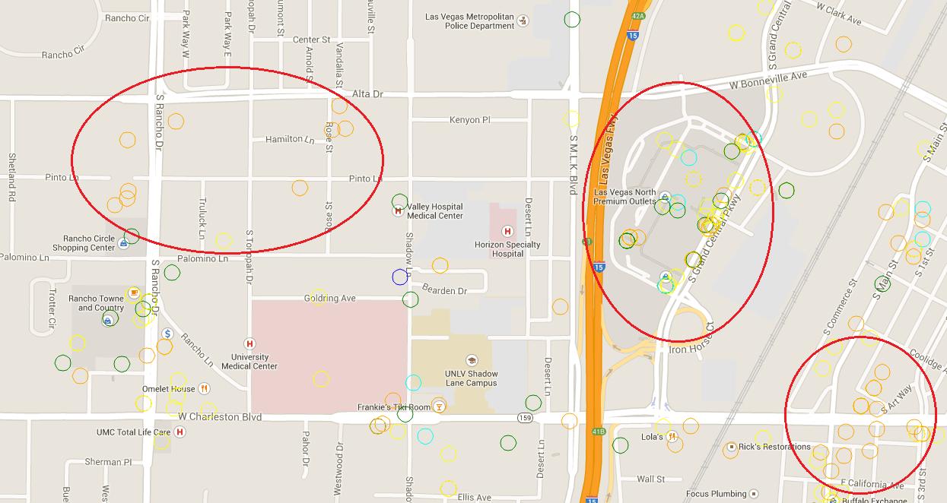

Slide 20
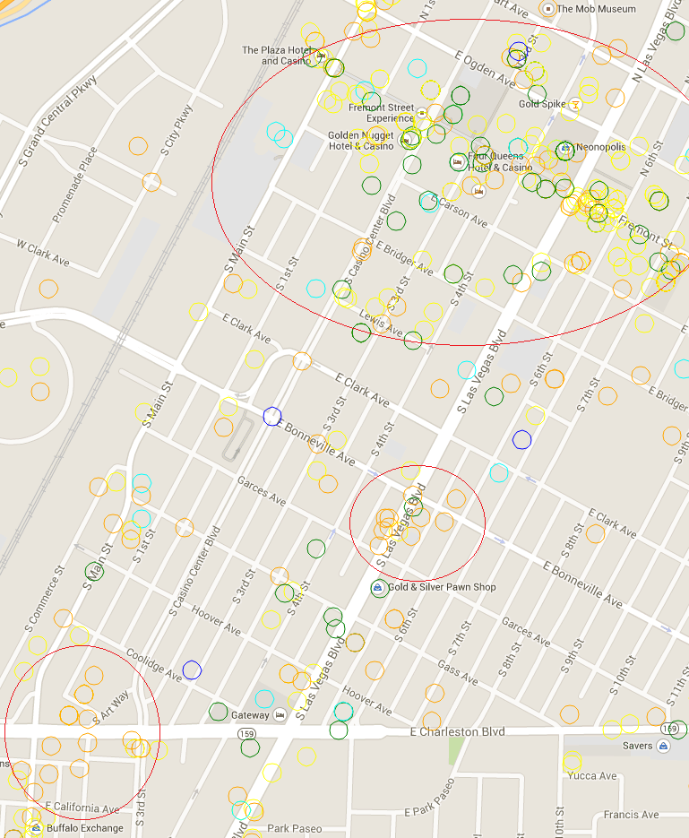

Slide 21
Rating and other features
Some of the main features were, as somewhat obvious, parking
No matter the type of business, clusters with more businesses providing parking spaces had higher rating

Slide 22
In conclusion
We created two types of inverted indices
Compared their performance
Used SPARK for machine learning algorithm – Kmeans
Trying to find relations between good rating and other features

Slide 23
References
Jimmy Lin and Chris Dyer - “Data-Intensive Text Processing with MapReduce
Mllib Clustering - https://spark.apache.org/docs/latest/mllib-clustering.html
Shivaraman Venkata – “Machine Learning on Spark”
Yelp Dataset Challenge - http://www.yelp.com/dataset_challenge

